Slide 1

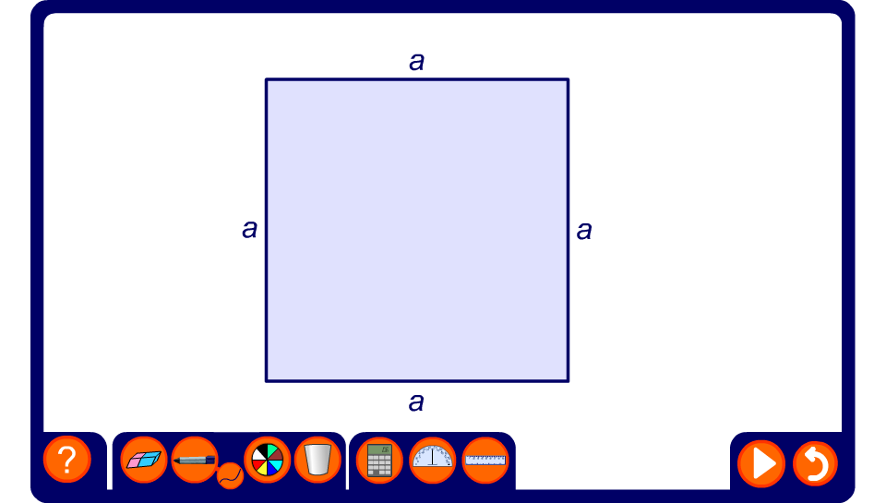


The difference between two squares
Notes:
This animation demonstrate geometrically why a² – b² = (a – b)(a + b).
The first two steps in the animation demonstrate a square of area b² being subtracted from a square of area a² to give a shape of area a² – b².
The shape of area a² – b² is then rearranged in to a rectangle of width a + b and height a – b to show that its area is equal to (a – b)(a + b).
a² – b² is therefore equal to (a – b)(a + b).

